Slide 1
Discussion Questions for Paper 1
Zhiyong Shan Spring 2021

Slide 2
Questions from Section 2
Please use Listing 1 to explain:
What is taint analysis
What is the motivation of the paper.

Slide 3
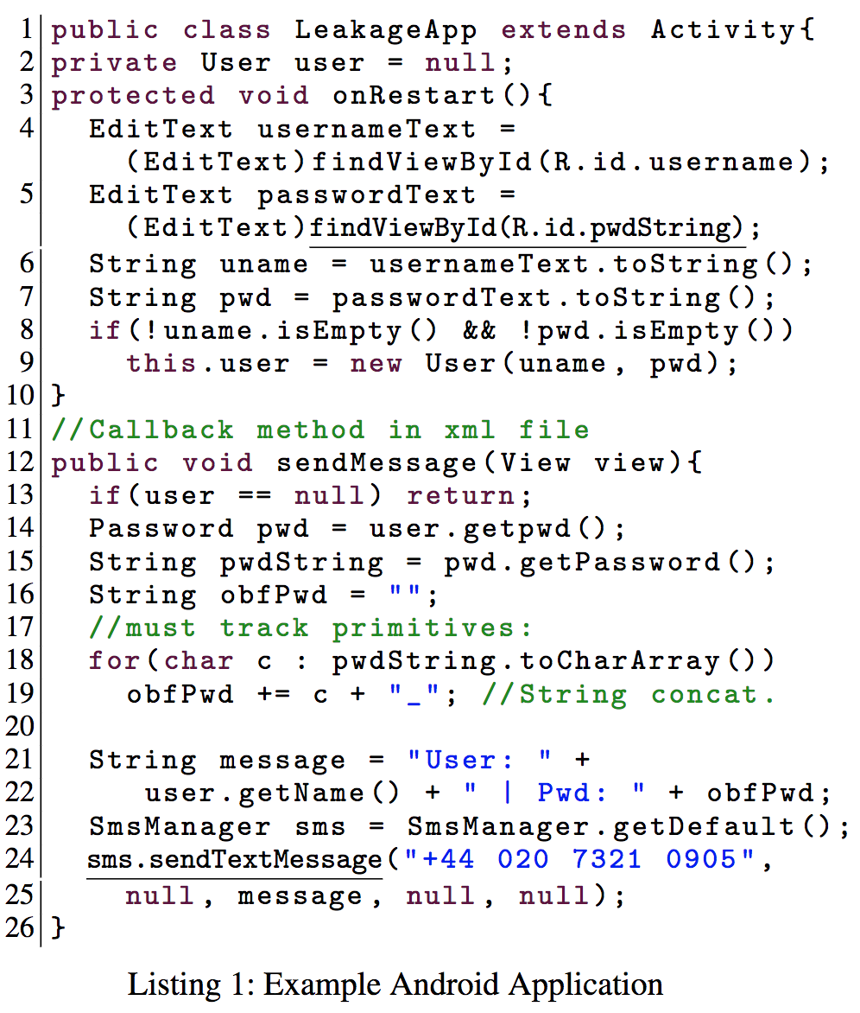

Slide 4
Questions from Section 3
Why does Flowdroid generate a dummy main function
How to generate the dummy main function. Please use Figure 1 to explain.

Slide 5
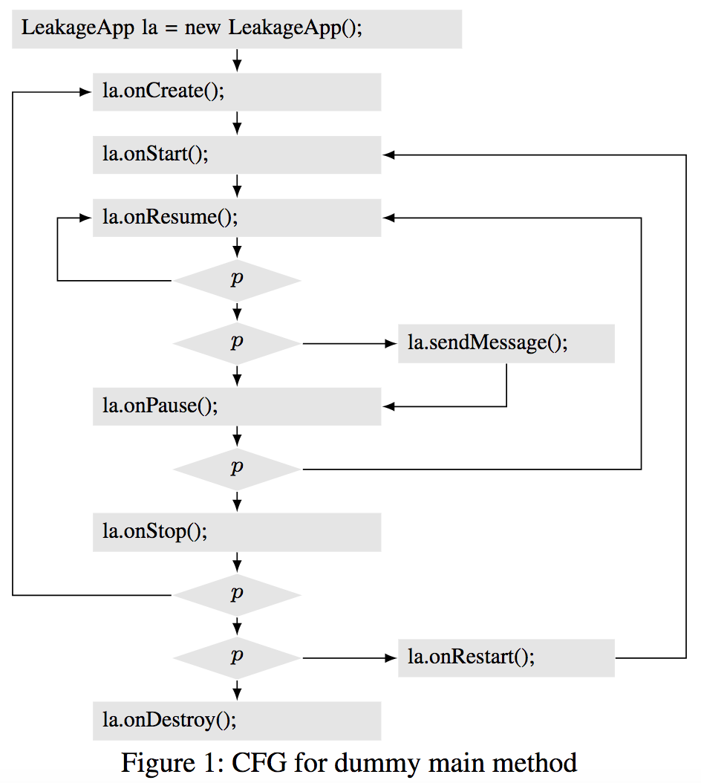

Slide 6
Questions from Section 4
Please use Figure 2 to explain the taint analysis in Flowdroid.

Slide 7
